Slide 1
9/4/24 Meeting

Slide 2
Regarding VM testing of the malconv
Idea!
.EXE files cannot run on Linux/Mac environments (and therefore do not constitute threats)
ISU already has Linux VMs available
Also, potentially, speak to Dr. Follman or another at ISU who knows about the XSEDE servers and using their GPU capacity for running our large-scale tests later on
Note: Malconv authors stated “16.75 hours per epoch” using GPU
E.g.: No GPU == No Chance
Packages can be added later if needed but, for now, those used in the malconv are:
argparse, keras, numpy, os, pandas, pickle, tensorflow, time, warnings

Slide 3
Regarding VM testing of the malconv [Cont.]
Problem:
Windows OS Hardware most common:
At the end of the day, the file is stored somewhere and, if that somewhere runs the Windows OS and has security enabled, it will set off alarm bells.
Prevents testing on any VMs I can spin-up on my home PC

Slide 4
“A comprehensive survey…” (Gopinath M. et al.)
General Notes:
Reviews other research papers: likely to be good reference for finding additional reading
Also cites the EtWE paper but does not talk in-depth to any length on its architecture or design
Thought: paper makes extensive mention of False-Positives and their mitigation.
I consider this a mistake, as classifying a benign process as malware has the impact of mere user inconvenience, but falsely classifying malware as benign can have immense consequences.
True Positive maximization and False Negative minimization are of primary concern.
“Being proactive rather than reactive is a key lesson that security gives us.” (pg 30)

Slide 5
“A comprehensive survey…” (Gopinath M. et al.) [Cont.]
Immediately-Relevant Points:
“Malware dataset is a key factor for malware detection.” (pg. 4)
“NSL KDD, Drebin, MS malware classification challenge, ClaMP, AAGM, and EMBER are some examples of datasets used so far”
“The accuracy of detection does not depend on incrementing the hidden layers. Two and more layered neural networks result in lesser performance than single-layered neural networks.” (pg. 7)
64.31% of Windows malware are Trojans (pg. 15)
Click this EXE, please.

Slide 6
“A comprehensive survey…” (Gopinath M. et al.) [Cont.]
Further Research (Options for Us):
Optimization of Existing Architectures
RNN gives 98% detection accuracy in IoT (pg. 8)
RFE sys called PAIRED is 98% in Android (pg. 8)
Lempel–Ziv Jaccard Distance (LZJD) is 98.89% (pg 11)
GDroid (GCN) is 98.99% in Android (pg 13)
HamDroid (Perceptron) is 98.62% in Android (pg 14)
Android Malware Detection (AMD) is 98.05% (pg 24)
Best successes mentioned
Potential route for optimization (reach 99+%)

Slide 7
“A comprehensive survey…” (Gopinath M. et al.) [Cont.]
Further Research (Options for Us) [Cont.]:
Mac OS security
“As there are no malware defence systems, it is crucial to concentrate on Mac OS.” (pg 14)
Ignore the contradiction to this in the 1st sentence of section 5.2.2. Context leads me to believe it may be a mistake by the authors.
Idea: Domain Specification
“A cross-platform approach to analysing IoT malware where printable strings are first extracted from ELF files after IoT malware collection.” (pg. 16)
IoT devices are a subsection of computing that does not involve printing to a screen
Therefore, this information leads to specification in malware detection:
“Based on the results, 99% accuracy is attained in a similar platform of training and testing with the data set which contains 120k IoT malware executable files.”

Slide 8
“A comprehensive survey…” (Gopinath M. et al.) [Cont.]
Further Research (Options for Us) [Cont.]:
Where-Not-To-Go: Ransomware Detection
“CryptoDrop attained a 100% of True Positive Rate (TPR), 1% of False Positive Rate (FPR) and 1–16 ms overhead based on the results.” (pg. 19)
“R-Locker achieved 100% TPR and 0% of FPR.” (pg. 19)
Context-Aware Entropy Analysis -- “100% TPR and 0% FPR are attained as results after experimentation.” (pg. 20)
Provided these statistics are accurate, the field appears solved.

Slide 9
“A comprehensive survey…” (Gopinath M. et al.) [Cont.]
Further Research (Options for Us) [Cont.]:
Where-Not-To-Go (?): CNN
Deep Learning methods not resilient to attacker retaliation
“Evasion attacks make it harder to detect malwares while using deep learning.” (pg. 22)
“Crafted inputs avoid machine learning models, and it leads to failure of classification. While using the DREBIN dataset, the misclassification rate is raised to 80%.” (pg. 22)
EtWE paper cited:
“MalConv network is utilized for this implementation with a 60% rate of evasion.” (pg 22-23)

Slide 10
“A comprehensive survey…” (Gopinath M. et al.) [Cont.]
Further Research (Options for Us) [Cont.]:
Classification
Paper suggests gap in research: Taxonomy (pg. 3)
Extensive focus on detection; little-to-none on classification
Would be useful for meta-analysis (“I know that you know that I know that you know…”)
“Over 50% of digitally connected people are using windows in this world. To avoid the increased number of violations in the Windows environment hybrid analysis methods are applied for feature extraction and Deep Learning models like CNN are employed for classifying malwares instead of ML classifiers.” (pg 29)
Android
The android environment seems more unsafe than Mac OS where personal information is mainly targeted. Mobile malware detection methods utilize static, dynamic, and image-based analysis techniques. For feature extraction also ML classifiers are utilized and classification is performed by adopting DL models.” (pg 30)

Slide 11
“A comprehensive survey…” (Gopinath M. et al.) [Cont.]
If we were to specify research on Classification, the paper lists (pg 4):
Bayesian Network (BN)
Naive Bayes (NB) *
Decision Tree (DT) *
Logistic Model Trees (LMT)
Random Forest Tree (RF) *
K-Nearest Neighbour (KNN) *
Multi Layer Perceptron (MLP)
Simple Logistic Regression (SLR)
Support Vector Machine (SVM) *
Sequential Minimal Optimization (SMO)
* = “...better accuracy is obtained with them than with existing architectures.” (pg. 5)

Slide 12
“A comprehensive survey…” (Gopinath M. et al.) [Cont.]
If we were to continue research on the CNN detection method:
“Kolosnjaji et al. proposed a model by merging CNN and LSTM where API call sequences are observed by CNN and the relationships are carried by LSTM [52]. Outputs from the convolutional layers are connected to forward and backward layers of LSTM in the CNN-BiLSTM model [85]. Outputs of those LSTM layers are combined to provide an output.” (pg. 7)
[52] = https://link.springer.com/chapter/10.1007/978-3-319-50127-7_11
[85] = https://www.sciencedirect.com/science/article/pii/S1742287618302032

Slide 13
“A study on malicious…” (Manihiro et al.)
General Notes:
Much of the information contained in this paper can also be found in the other
Also cites the EtWE paper
Slight increase in depth at the sacrifice of breadth (~100 fewer citations and 18 fewer pages)
Unlike previous paper, it specifies the list of locations the reviewed papers were retrieved from
“...IEEE Xplore (IEE/IEEE), Association for Computing Machinery (ACM) Digital Library, Web of Science, ScienceDirect, SpringerLink and Google Scholar…” (pg 3)
“...queried for seven key terms: ‘malware analysis’, ‘malware behaviour analysis’, ‘malware detection’, ‘dynamic malware analysis’, ‘memory analysis’, ‘machine learning’ and ‘deep learning’...” (pg 3)
Also specifies focus in the Windows OS

Slide 14
“A study on malicious…” (Manihiro et al.) [Cont.]
Immediately Relevant Points:
Additional Tools to Consider (pg 5)
Emulation in addition to or instead of a VM
Emulate other OS’s even?
Memory Acquisition
Hardware Tools: Tribble or Firewire
Commercial Testbeds
IBM X-Force Command Centre
The Ixia BreakingPoint and Cyber Exata
Comprehensive list in table 3 on (pg 6)
Malware Datasets listed in section 4.6 (pg 7)

Slide 15
“A study on malicious…” (Manihiro et al.) [Cont.]
Further Research (Options for Us):
Memory Analysis Techniques
“Essentially, in order for a program (either benign or malicious) to be executed, it must be first loaded in memory and therefore, making the memory analysis technique the most suitable and preferred technique for identifying sophisticated malware behaviours.” (pg 2)
Idea: Malware Detection Suite
Paper mentions Ensemble Learning Technique (pg 9)
Also mentions, as the previous paper did, evasion techniques used to fool the MalConv model (pg 13)
Solution: suite of programs all performing simultaneous malware analysis
Malware which fools one may not do so for another

Slide 16
“A study on malicious…” (Manihiro et al.) [Cont.]
Further Research (Options for Us):
Memory Analysis Techniques
“Essentially, in order for a program (either benign or malicious) to be executed, it must be first loaded in memory and therefore, making the memory analysis technique the most suitable and preferred technique for identifying sophisticated malware behaviours.” (pg 2)
Idea: Malware Detection Suite
Paper mentions Ensemble Learning Technique (pg 9)
Also mentions, as the previous paper did, evasion techniques used to fool the MalConv model (pg 13)
Solution: suite of programs all performing simultaneous malware analysis
Malware which fools one is unlikely to do so for all others

Slide 17
EtWE paper (Raff et al.)
Notable Details on re-reading:
Section 2.2 (pg 2) cites a paper working on malware identification from just the first 300 bytes
Section 3 on training data (pg 3) -- Caution not to allow datasets to represent benignness as “from Microsoft”
“We were able to train this model on the 400k Group B set using data parallelism across the 8 GPUs of a DGX-1 in 16.75 hours per epoch, for 10 epochs, and using all available GPU memory. Training on the larger 2 million set took one month on the same system.” (pg 5)
“We use this larger dataset to show that our new MalConv architecture continues to improve with increased training data, while the byte n-gram approach appears to have plateaued in terms of performance.” (pg 3)

Slide 18
EtWE paper (Raff et al.) [Cont.]
Notable Details on re-reading [Cont.]:
Another Research Path for us:
“The prevalence of packing in malicious executables leads to many models learning a direct (but unhelpful) equivalence between “packed” and “malicious”. ...our model may have avoided such an association. We hope further advances in interpretable models will help us to confirm this behavior...” (pg 6)
Appendix contains models which performed worse than MalConv (pg 8-10)
What-Not-To-Do Section

Slide 19
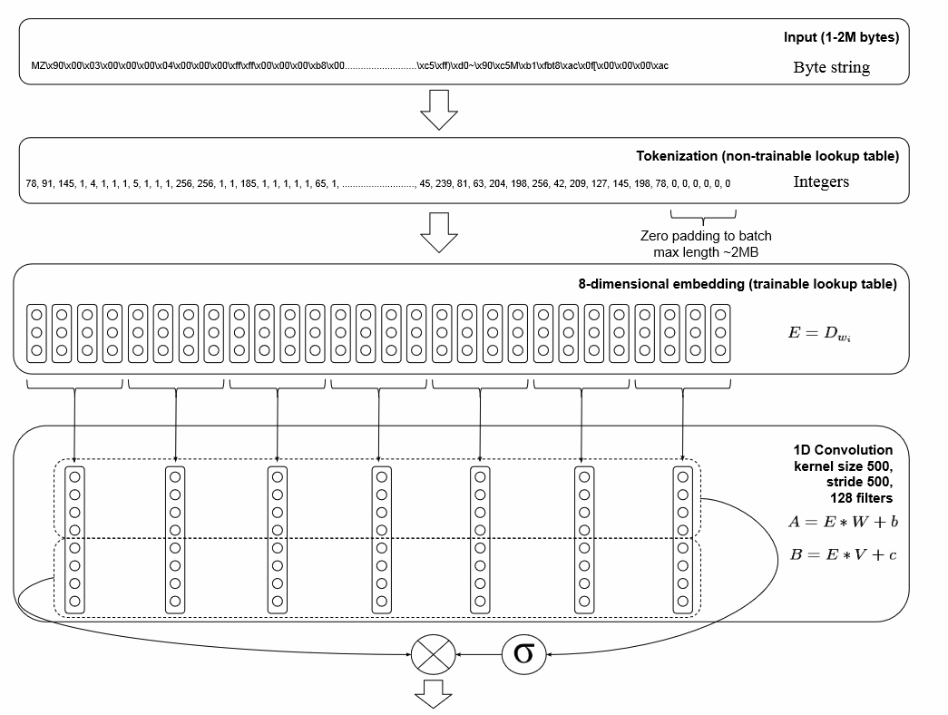
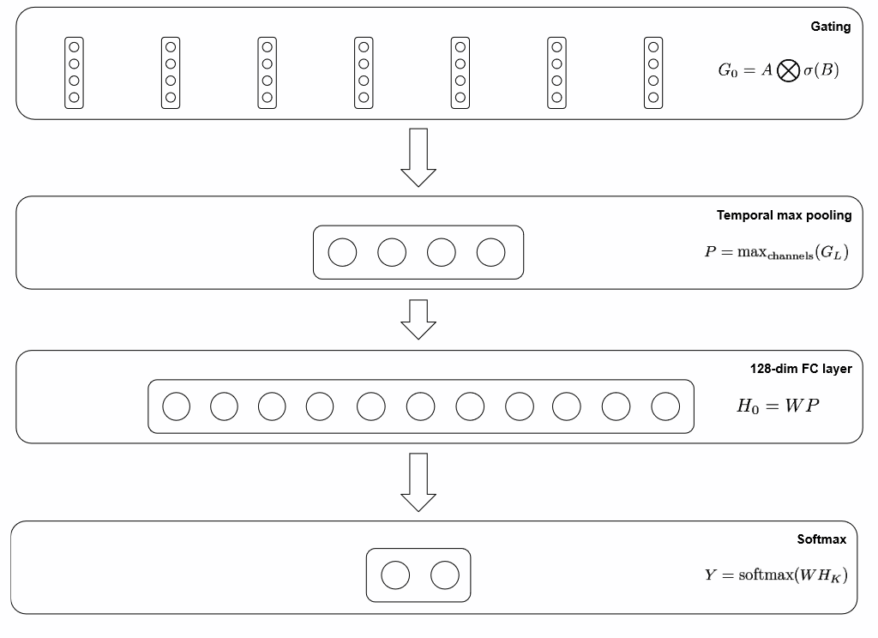
EtWE paper (Raff et al.) [Cont.]
Architecture (pg 11):

Slide 20
EtWE paper (Raff et al.) [Cont.]
Code (GitHub):
https://github.com/j40903272/MalConv-keras/tree/master/src

